Slide 1

Chapter 7
Constructors and Other Tools
Copyright © 2017 Pearson Education, Ltd. All rights reserved.

Slide 2
Learning Objectives
Constructors
Definitions
Calling
More Tools
const parameter modifier
Inline functions
Static member data
Container: Vectors
Introduction to vector class

Slide 3
Safety Issues on Initialization in C
Most of C bugs occur when the users forgets to initialize or clean up a variable
Users don’t know how to initialize a struct, or even that they must

Slide 4
Constructors
Initialization of objects
Initialize some or all member variables
Other actions possible as well
A special kind of member function
Automatically called when object declared
Very useful tool
Key principle of OOP

Slide 5
Constructor Definitions
Constructors defined like any member function
Except:
Must have same name as class
Cannot return a value; not even void!

Slide 6
Constructor Definition Example
Class definition with constructor:
class DayOfYear { public: DayOfYear(int monthValue, int dayValue); //Constructor initializes month and day void input(); void output(); … private: int month; int day; }

Slide 7
Constructor Notes
Notice name of constructor: DayOfYear
Same name as class itself!
Constructor declaration has no return-type
Not even void!
Constructor in public section
It’s called when objects are declared
If private, could never declare objects!
But it is useful in some cases…
??? weeks later…

Slide 8
Calling Constructors
Declare objects: DayOfYear date1(7, 4), date2(5, 5);
Objects are created here
Constructor is called
Values in parens passed as arguments to constructor
Member variables month, day initialized: date1.month → 7 date2.month → 5 date1.dat → 4 date2.day → 5
Notes:
沒寫input的話，compiler會自動跟你說
可以避免使用者必須做，但卻不知道的事情，因為compiler會給error

Slide 9
Constructor Equivalency
Consider:
DayOfYear date1, date2 date1.DayOfYear(7, 4); // ILLEGAL! date2.DayOfYear(5, 5); // ILLEGAL!
Seemingly OK…
CANNOT call constructors like other member functions!

Slide 10
Constructor Code
Constructor definition is like all other member functions: DayOfYear::DayOfYear(int monthValue, int dayValue) { month = monthValue; day = dayValue; }
Note same name around ::
Clearly identifies a constructor
Note no return type
Just as in class definition

Slide 11
Alternative Definition
Previous definition equivalent to: DayOfYear::DayOfYear( int monthValue, int dayValue) : month(monthValue), day(dayValue) ← {…}
Third line called "Initialization Section"
Body left empty
Preferable definition version

Slide 12
Which one executes first?
int main(){
DayOfYear variable1(12,20);
}
DayOfYear::DayOfYear( int monthValue, int dayValue) : month(monthValue), day(dayValue) {
month = 2;
day = 14;
}

Slide 13
Constructor Additional Purpose
Not just initialize data
Body doesn’t have to be empty
In initializer version
Validate the data!
Ensure only appropriate data is assigned to class private member variables
Powerful OOP principle

Slide 14
Overloaded Constructors
Can overload constructors just like other functions (Function Overloading)
Recall: a signature consists of:
Name of function
Parameter list
Provide constructors for all possible argument-lists
Particularly "how many"

Slide 15
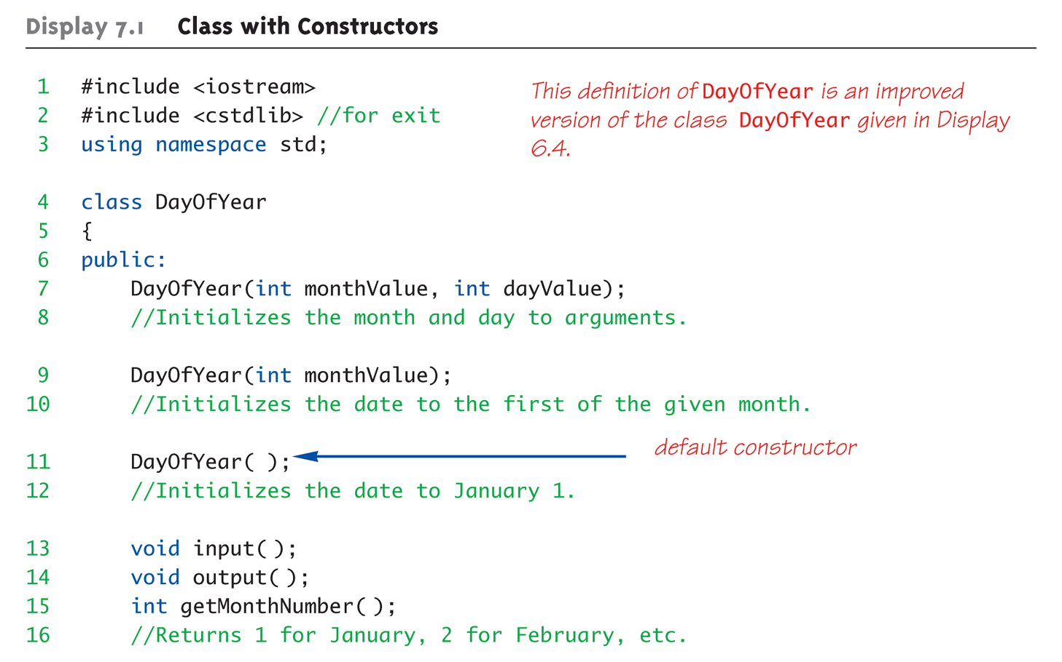
Class with Constructors Example: Display 7.1 Class with Constructors (1 of 3)

Slide 16
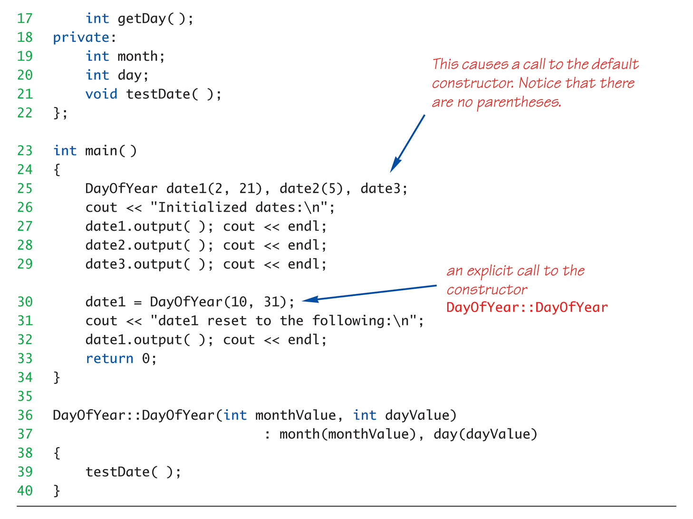
Class with Constructors Example: Display 7.1 Class with Constructors (2 of 3)

Slide 17
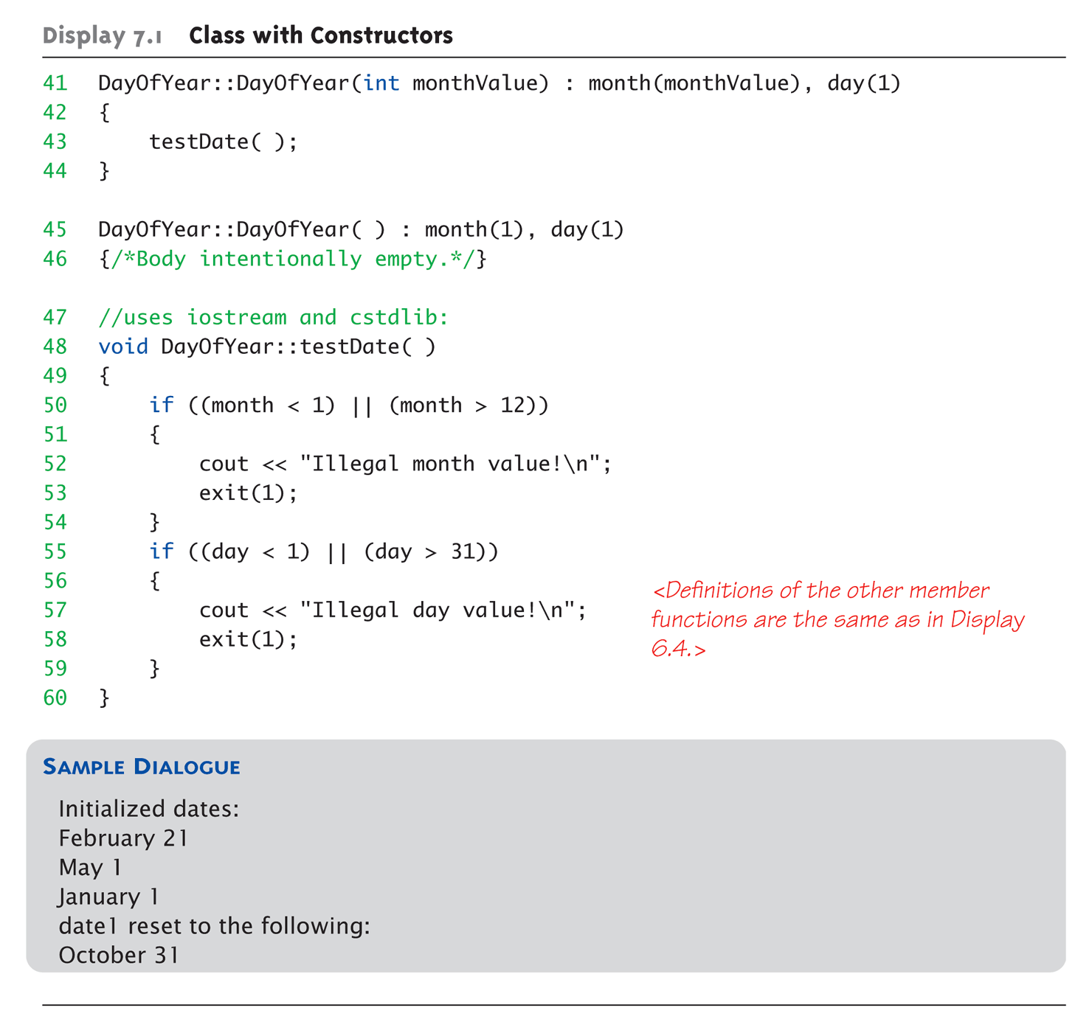
Class with Constructors Example: Display 7.1 Class with Constructors (3 of 3)

Slide 18
Constructor with No Arguments
Can be confusing
Standard functions with no arguments:
Called with syntax: callMyFunction();
Including empty parentheses
Object declarations with no "initializers":
DayOfYear date1; // This way!
DayOfYear date(); // NO!
What is this really?
Compiler sees a function declaration/prototype!
Yes! Look closely!
Notes:
避免跟宣告 function 混淆

Slide 19
Explicit Constructor Calls
Can also call constructor AGAIN
After object declared
Recall: constructor was automatically called then
Can call via object’s name; standard member function call
Convenient method of setting member variables
Method quite different from standard member function call
Notes:
下一頁有範例

Slide 20
Explicit Constructor Call Example
Such a call returns "anonymous object"
Which can then be assigned
In Action: DayOfYear holiday(7, 4);
Constructor called at object’s declaration
Now to "re-initialize": holiday = DayOfYear(5, 5);
Explicit constructor call
Returns new "anonymous object"
Assigned back to current object
Notes:
回去看 gage 16

Slide 21
Aggregate Initialization
Arrays of simple type
int a[5] = { 1, 2, 3, 4, 5 };
Assign zero for all the elements w/o initializers
int b[6] = {1}; // {1, 0, 0, 0, 0, 0}
struct X { int i; float f; char c;};
X x2[3] = { { 1, 1.1, ‘a’}, { 2, 2.2, ‘b’} };
class Y {private: int i; float f; public: Y(int a, float b)};
Y y1[3] = { Y(1,1.1), Y(2,2.2), Y(3, 3.3) };

Slide 23
Default Constructor
Defined as: constructor w/ no arguments
One should always be defined
Auto-Generated?
Yes & No
If no constructors AT ALL are defined → Yes
If any constructors are defined → No
If no default constructor (but with other constructors) :
Cannot declare: MyClass myObject;
With no initializers
Generate compile-time errors
Notes:
會幫你自動產生一個 constructor，如果你都沒定義的話

Slide 24
Class Type Member Variables
Class member variables can be any type
Including objects of other classes!
Type of class relationship
Powerful OOP principle
Need special notation for constructors
So they can call "back" to member object’s constructor
Notes:
物件裡面可以有物件，初始化的時候，也可以使用 Initialization Section

Slide 25
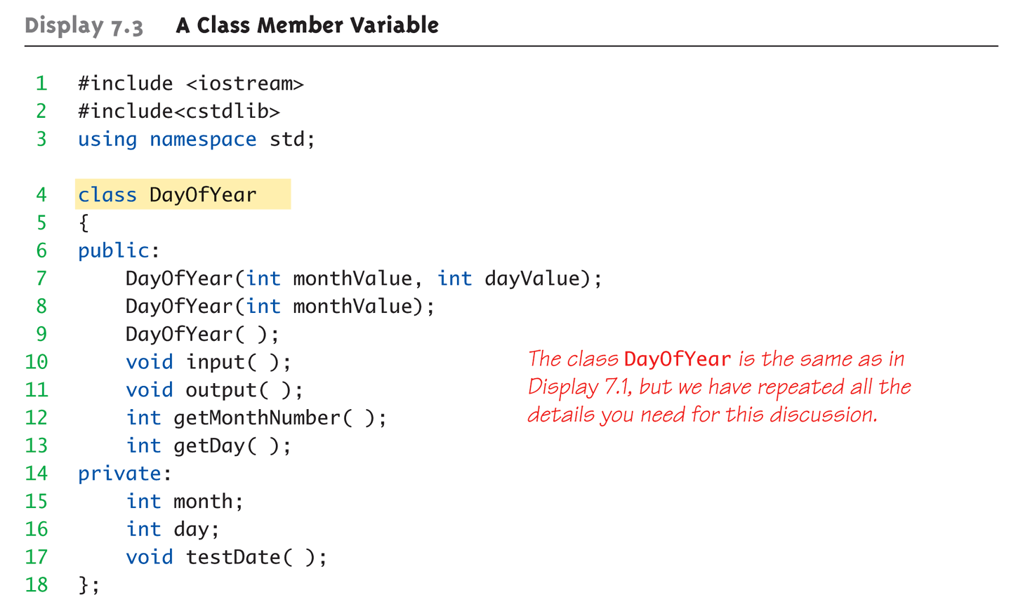
Class Member Variable Example: Display 7.3 A Class Member Variable (1 of 5)
Notes:
先宣告日期的class
Private 裡頭有一個 function 在測試這個日期是否正確，testDate()

Slide 26
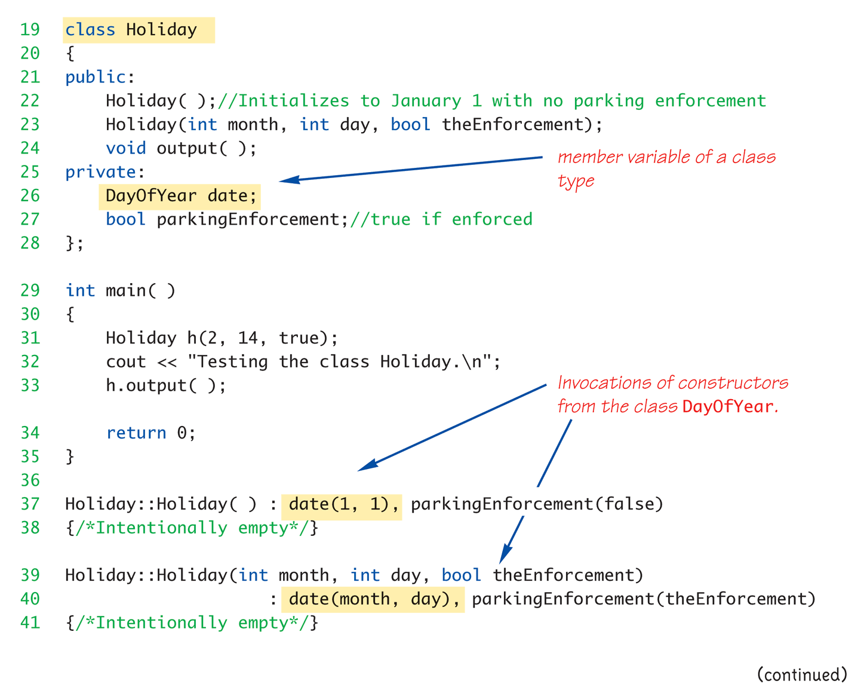
Class Member Variable Example: Display 7.3 A Class Member Variable (2 of 5)
Notes:
在宣告假日的class
裡面有用到date
parkingEnforcement 表示停車的規定是否會嚴格執行

Slide 27
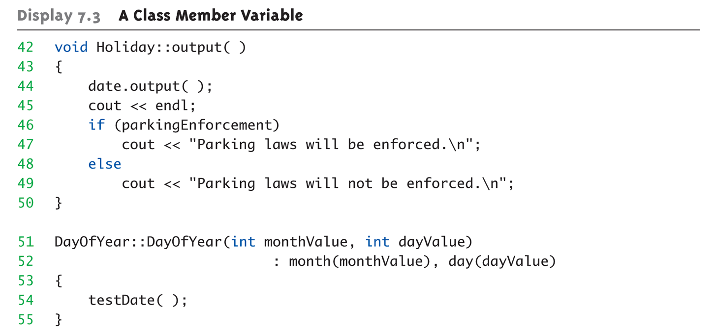
Class Member Variable Example: Display 7.3 A Class Member Variable (3 of 5)

Slide 28
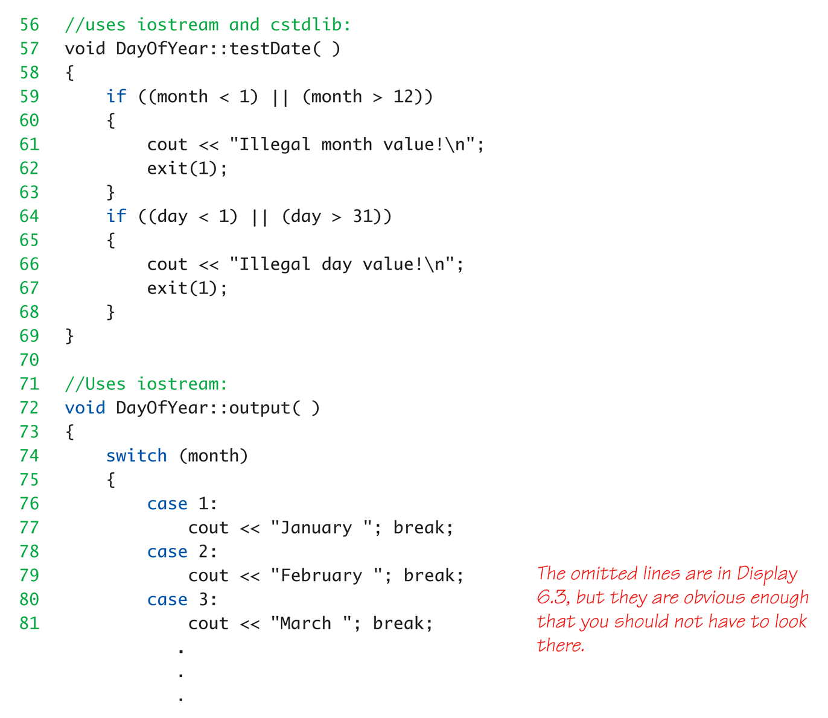
Class Member Variable Example: Display 7.3 A Class Member Variable (4 of 5)

Slide 29
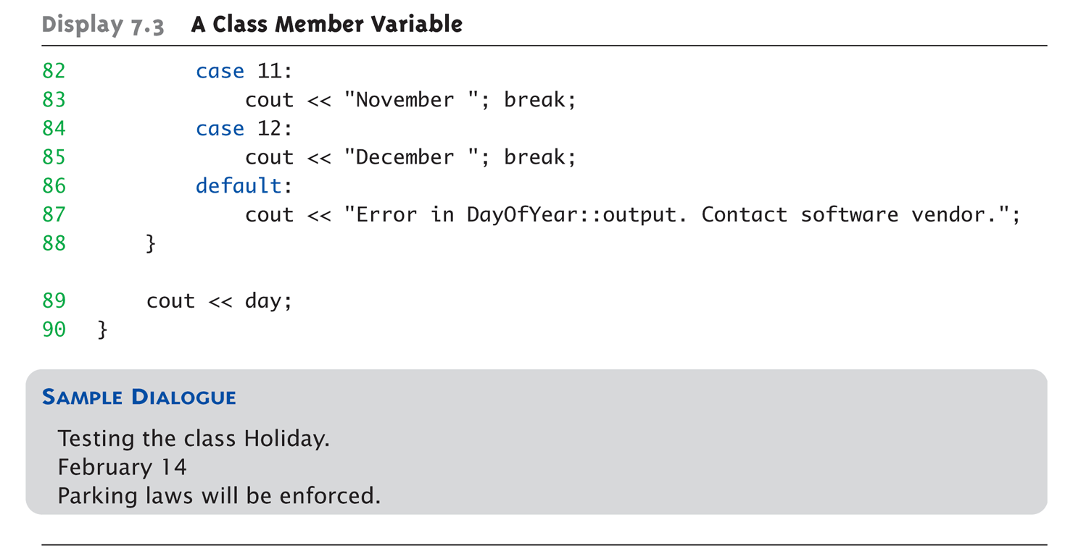
Class Member Variable Example: Display 7.3 A Class Member Variable (5 of 5)

Slide 30
Member Initializers
C++11 supports a feature called member initialization
This feature allows you to set default values for member variables
class Coordinate
{
public:
Coordinate();
private:
int x=1;
int y=2;
};
Coordinate::Coordinate()
{ }
Member
Initializers
Coordinate c1;
Initializes c1.x to 1 and c1.y to 2

Slide 31
Constructor Delegation
C++11 allows one constructor to invoke another
The default constructor invokes the constructor to initialize x and y to 99,99
Coordinate::Coordinate(int xval, int yval) : x(xval), y(yval)
{ }
Coordinate::Coordinate() : Coordinate(99,99) { }

Slide 32
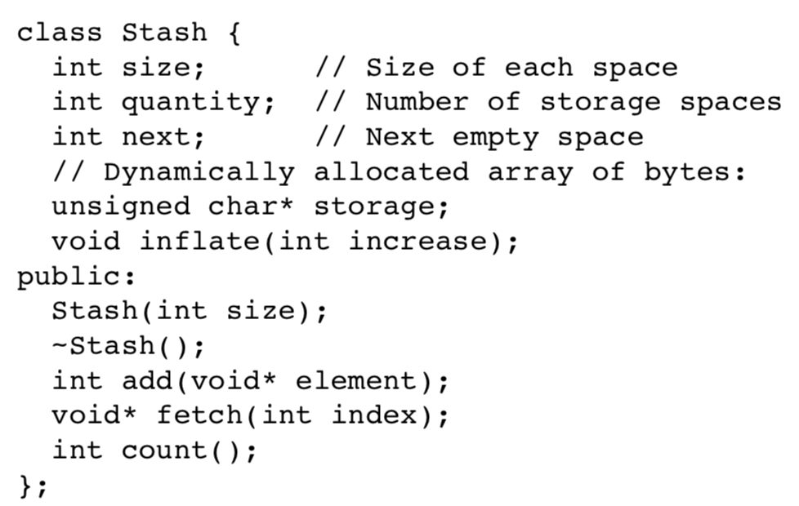
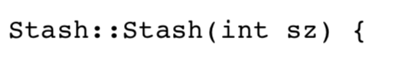
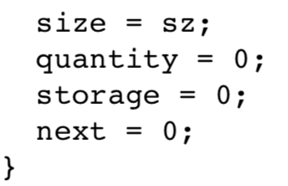
Initialize/Constructor for Stash
You can replace function initialize() with a constructor

Slide 33
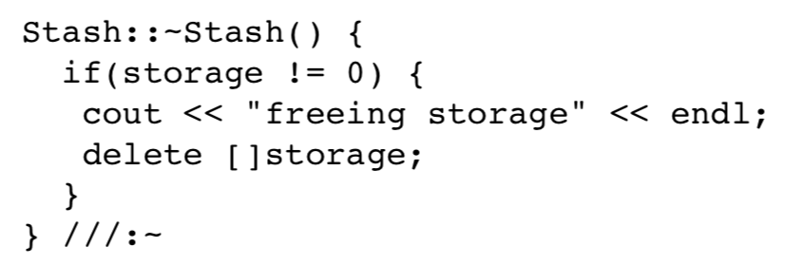
Destructor?
Typically, you don’t need it
But if you use something similar to malloc in the constructor…
You need to free the memory
Will be introduced in Chapter 10 with pointers and dynamic arrays

Slide 35
Parameter Passing Methods
Efficiency of parameter passing
Call-by-value
Requires copy be made → Overhead
Call-by-reference
Placeholder for actual argument
Most efficient method
Negligible difference for simple types
For class types → clear advantage
Call-by-reference desirable
Especially for "large" data, like class types

Slide 36
The const Parameter Modifier
Large data types (typically classes)
Desirable to use pass-by-reference
Even if function will not make modifications
Protect argument
Use constant parameter
Also called constant call-by-reference parameter
Place keyword const before type
Makes parameter "read-only"
Attempt to modify parameter results in compiler error

Slide 37
Use of const
All-or-nothing
If no need for function modifications
Protect parameter with const
Protect ALL such parameters
This includes class member function parameters
Input a const obj. to a funct. without const protection (X)
Call a non-const funct. in a funct. with const protection (X)
Notes:
加了 const 字眼，就保護到底了，出現有機會改到變數的，就會跳 error

Slide 38
Chap 4: Constant Reference Parameters
Reference arguments inherently "dangerous"
Caller’s data can be changed
Often this is desired, sometimes not
To "protect" input data, & still pass by reference:
Use const keyword
Protect arguments with const
void sendConstRef( const int &par1, const int &par2);
Protect all the member variables in class definition
void sendConstRef( int &par1, int &par2) const;
Notes:
Function 後面直接掛 const 表示，這個 function 不會改到 class 裡面的 member variables

Slide 40
Preprocessor Pitfalls (1/3)
Preprocessor will be inserted in the code directly for efficiency
Act like a function (but not a function…)
Quite easy to fall into the fiction
Define a preprocessor to calculate the area of a circle
#define AREA_CIRCLE (r) 3.14*r*r
You will get compiler error. Why?
The space should be removed!
#define AREA_CIRCLE(r) 3.14*r*r

Slide 41
Preprocessor Pitfalls (2/3)
Define a preprocessor to get the floor value
#define FLOOR(x,b) x>=b?0:1
if ( FLOOR(a&0x0f, 0x07) )
What will happen?
if ( a& 0x0f>=0x07 ?0:1 )
The precedence of & is lower than that of >=… It should be
#define FLOOR(x,b) (x)>=(b)?0:1

Slide 42
Preprocessor Pitfalls (3/3)
It is unpredictable…
#define BAND(x) (((x)>5 && (x)<10) ? (x):0)
int a = 4;
cout << BAND(++a) << endl;
cout << a << endl;
cout << BAND(++a) << endl;
cout << a << endl;
It will print…?
Notes:
0 ( a 這時候已經是 5 )
5 因為 && 確定一邊是 false 就不用繼續檢查第二個
8
8

Slide 43
Macros & Access in Class
You may want to write a MACRO to modify the private variables in an object
But Macro in C cannot be used in class definition
class X{
int i;
public:
#define VAL(X::i); // Error!!!
};
Make the variables public?? No way

Slide 44
Use Inline
C++ implements the macro as inline function to solve the macro problem in C
Any behavior you expect from an ordinary function
Use keyword inline
inline double AREA_CIRCLE(double r);
inline int FLOOR(int x, int b);
Inline int BAND(int x);
Define the functions inside classes ➔ Inline functions
Notes:
x = 5 and 8
0 and 8

Slide 45
Inline Functions
For non-member functions:
Use keyword inline in function declaration and function heading
For class member functions:
Place implementation (code) for function IN class definition → automatically inline
Use for very short functions only
Code actually inserted in place of call (similar to preprocessor)
Eliminates overhead
More efficient, but only when short!

Slide 46
Inline Member Functions
Member function definitions
Typically defined separately, in different file
Can be defined IN class definition
Makes function "in-line"
Again: use for very short functions only
Suitable for accessor and mutator functions
More efficient
If too long → actually less efficient!

Slide 48
Counter for Stash
Recall class Stash
Q: How many objects of Stash do we create?
Q: How much memory do we use?
Track them to prevent memory leak
How do we store the information?
Keep a global variable??
Declare it in the class!!!

Slide 49
Static Members
Static member variables
All objects of class "share" one copy
One object changes it → all see change
Objects can communicate with each other
Useful for "tracking"
How often a member function is called
How many objects exist at given time
Place keyword static before type
Notes:
如果是global variable/function宣告時候加上static，則表示這個variable只能在這個file裡使用
如果是local variable在function裡宣告時候加上static，則表示這個variable的值會一直被記得（應該是存在heap）

Slide 50
Static Functions
Member functions can be static
If no access to object data needed
And still "must" be member of the class
Make it a static function
Also can then be called outside class
From non-class objects:
E.g., Server::getTurn();
As well as via class objects
Standard method: myObject.getTurn();
Can only use static data, functions!

Slide 51
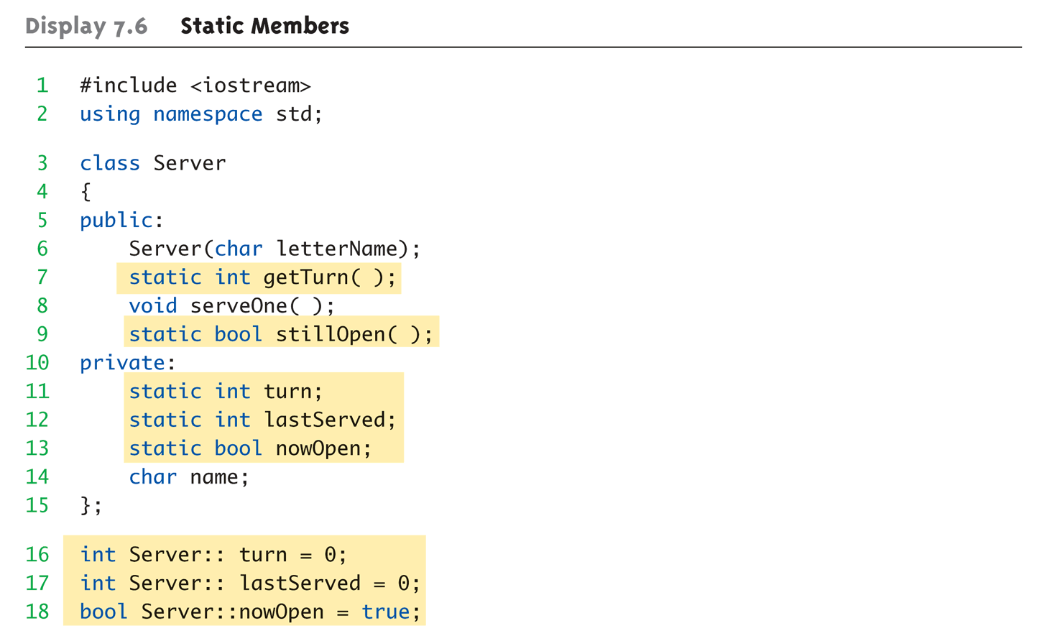
Static Members Example: Display 7.6 Static Members (1 of 4)

Slide 52
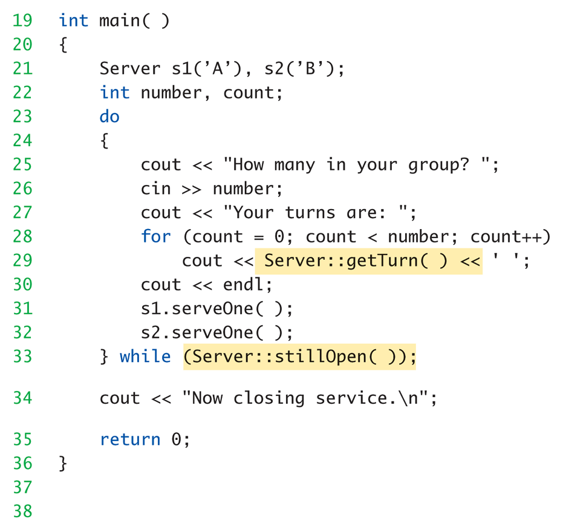
Static Members Example: Display 7.6 Static Members (2 of 4)

Slide 53
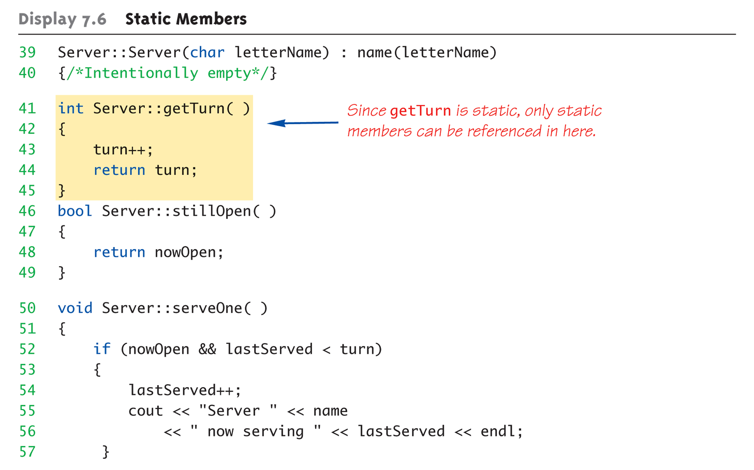
Static Members Example: Display 7.6 Static Members (3 of 4)

Slide 54
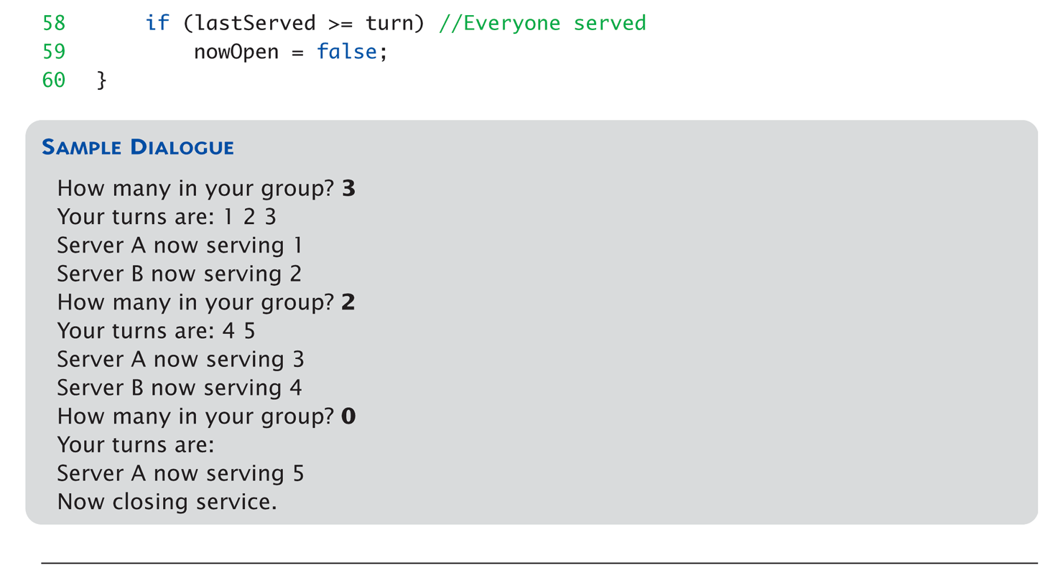
Static Members Example: Display 7.6 Static Members (4 of 4)

Slide 55
Pitfall: Counting via static int (1/3)
class A{
int a;
static int count;
public:
A() {count += 1;}
A(int _a): a(_a) { count += 1;}
~A() {count -= 1;}
static int getCount(){return count;}
};
int A::count = 0; //default setting
A f(A input) { return input; }

Slide 56
Pitfall: Counting via static int (2/3)
int main(){
A v1(3);
cout << A::getCount() << endl;
f(v1);
cout << A::getCount() << endl; }
A f(A input) { return input; }
Because the compiler perform a bit-copy
Notes:
1
-1

Slide 57
Pitfall: Counting via static int (3/3)
class A{
int a;
static int count;
public:
A() {count += 1;}
A(const A &ini) { a = ini.a; count += 1; }
A(int _a): a(_a) { count += 1;}
~A() {count -= 1;}
static int getCount(){return count;}
};
int A::count = 0; //default
You should carefully define Copy-Constructor
Notes:
We will introduce it again in Chapter 10

Slide 59
Vectors
Vector Introduction
Recall: arrays are fixed size
Vectors: "arrays that grow and shrink"
During program execution
Formed from Standard Template Library (STL)
Using template class
Vector is very similar to our Stash

Slide 60
Vector Basics
Similar to array:
Has base type
Stores collection of base type values
Declared differently:
Syntax: vector<Base_Type>
Indicates template class
Any type can be "plugged in" to Base_Type
Produces "new" class for vectors with that type
Example declaration: vector<int> v;

Slide 61
Vector Use
vector<int> v;
"v is vector of type int"
Calls class default constructor
Empty vector object created
Indexed like arrays for access “[ index ]”
Operator overloading in Chapter 8
But to add elements:
Must call member function push_back
Member function size()
Returns current number of elements

Slide 62
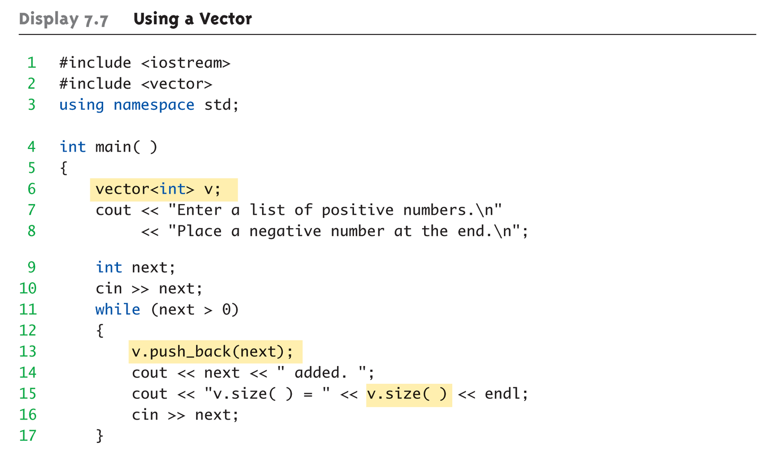
Vector Example: Display 7.7 Using a Vector (1 of 2)

Slide 63
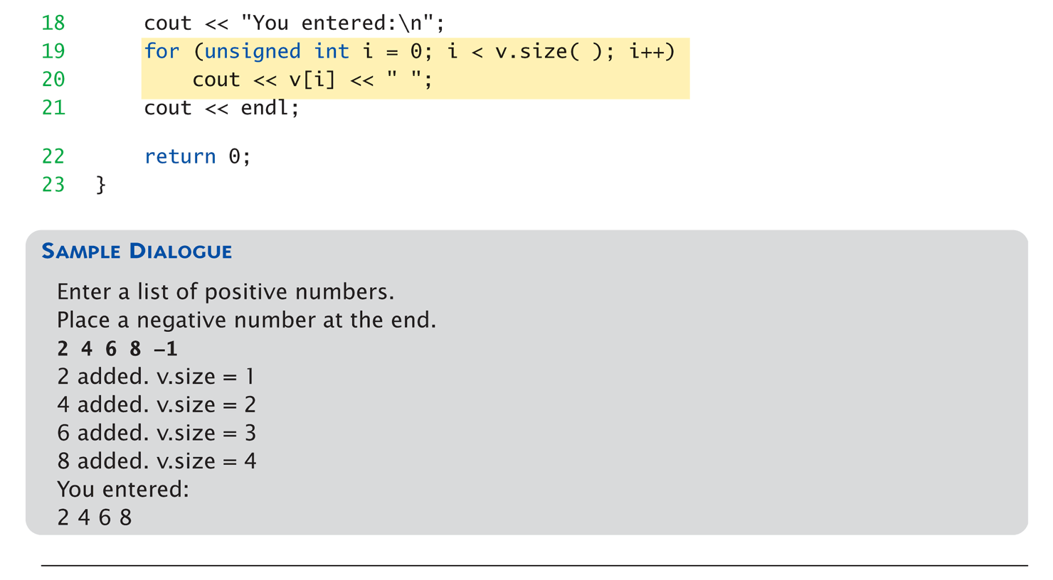
Vector Example: Display 7.7 Using a Vector (2 of 2)

Slide 64
Vector Efficiency
Member function capacity()
Returns memory currently allocated
Not same as size()
Capacity typically > size (unless it is saturated)
Automatically increased as needed
If efficiency critical:
Can set behaviors manually
v.reserve(32); //sets capacity to 32
v.reserve(v.size()+10); //sets capacity to 10 more than size
Note that v.size() only stores the number of used entries
Notes:
Operator overloading
v.size() + 10

Slide 65
Summary 1
Constructors: automatic initialization of class data
Called when objects are declared
Constructor has same name as class
Default constructor has no parameters
Should always be defined
Class member variables
Can be objects of other classes
Require initialization-section

Slide 66
Summary 2
Constant call-by-reference parameters
More efficient than call-by-value
Can inline very short function definitions
Can improve efficiency
Static member variables
Shared by all objects of a class
Vector classes
Like: "arrays that grow and shrink"

